Slide 1
Taipei Metro
Passenger Flow Prediction
-- Time Series Analytics
呂承洋 B02902025 林韋希 B02902035
黃亦晨 B02902053 陳柏堯 B02902071

Slide 2
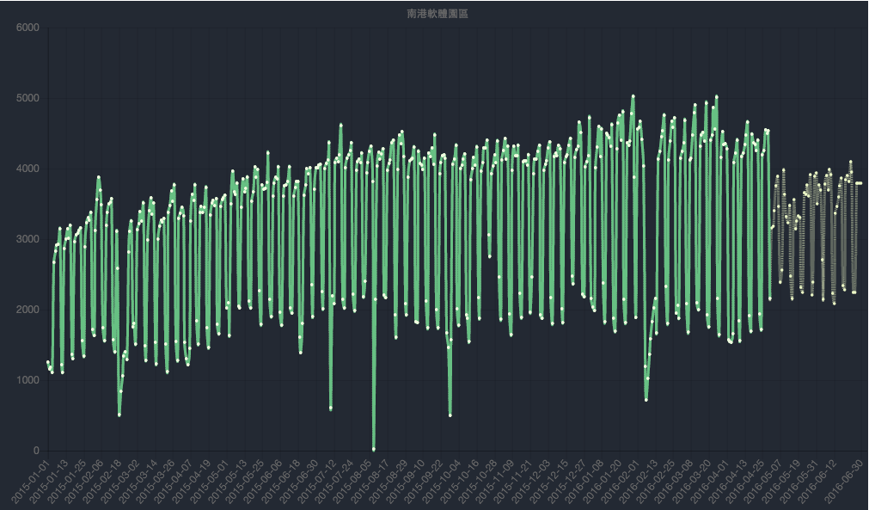
Purpose
Use of Taipei Open Data
Transportation / Traffic Schedule

Slide 3
DEmo
Click Me:
http://www.csie.ntu.edu.tw/~b02902053/TaipeiMetroAnalytics/index.html
Or
http://goo.gl/XlqYYr

Slide 4
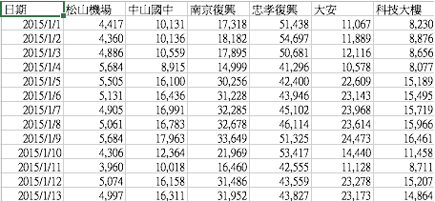
DATA Source
Taipei MRT stations passenger flow Statistics:
http://data.taipei/opendata/datalist/datasetMeta?oid=1d71c478-205f-42c5-8386-35f86d74fdd1

Slide 5
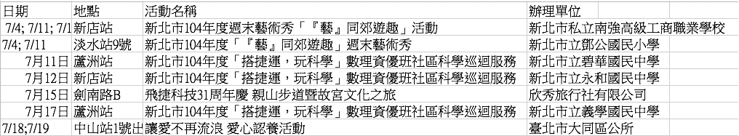
DATA Source
Taipei MRT stations activity calendar:
http://data.taipei/opendata/datalist/datasetMeta?oid=1d45dbac-3833-4a7c-8a05-ac3272d52f72

Slide 6
DATA Source
Vacation Calendar

Slide 7

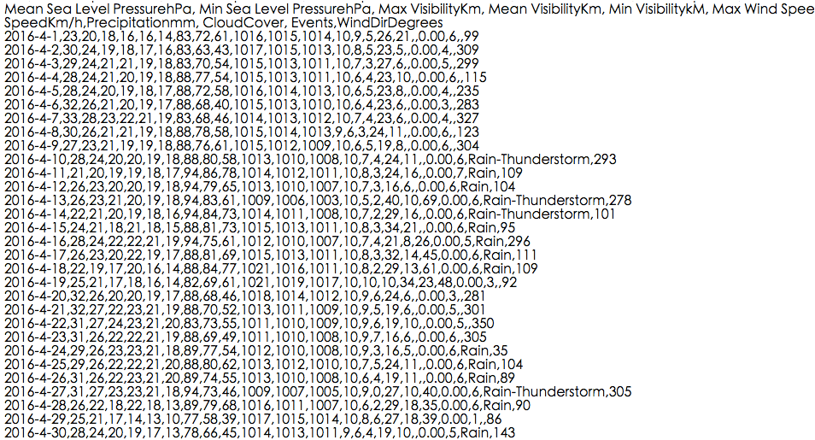
DATA Source
Weather Underground

Slide 8

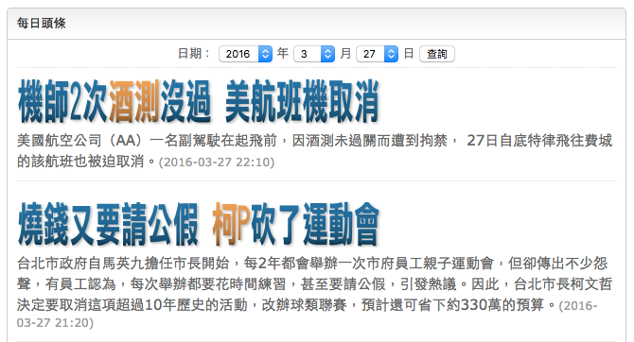
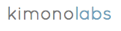

DATA Source
Ettoday News (Not used)
(tools)

Slide 9
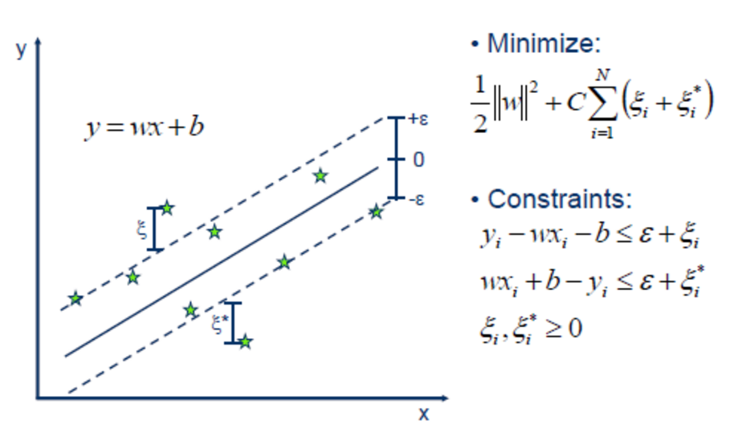
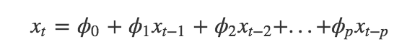
ALgorithm
Machine Learning Method: Support Vector Regression (SVR)
Statistics Learning Method: Autoregressive Moving-Average (ARMA)
White noise
Soheila Mehrmolaei. A Brief Survey on Event Prediction Methods in Time Series 10.1007/978-3-319-18476-0_24, 2015

Slide 10
Train
Test
2015 Jan 1st
2016 Apr 1st
2016 Apr 30th

Slide 11
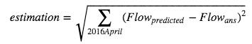
Estimation
Mean Squared Error
Matplotlib: watch pattern

Slide 12
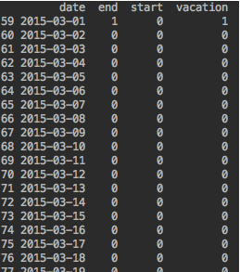
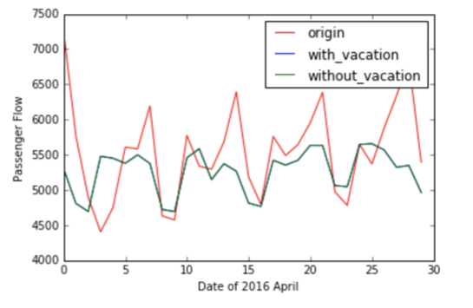
SVR Feature selection
(flew before Tsing Ming)
(Songshan Airport Station)
Vacation: too less data

Slide 13
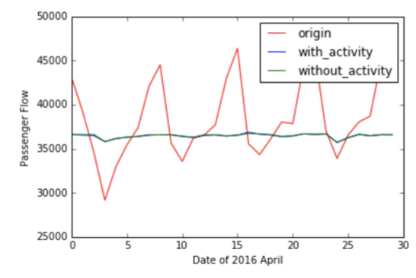
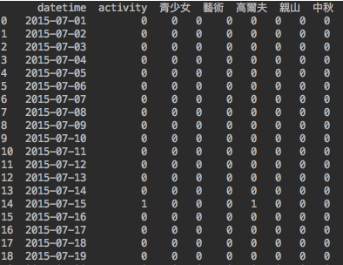
SVR Feature selection
(Zhongshan Station)
Activity

Slide 14
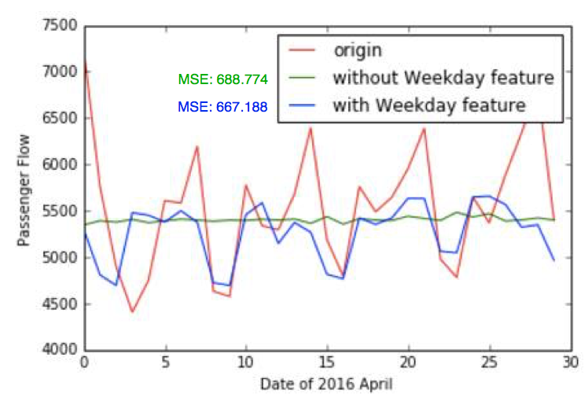
SVR Feature selection
(Songshan Airport Station)
Weekday Feature: Important

Slide 15
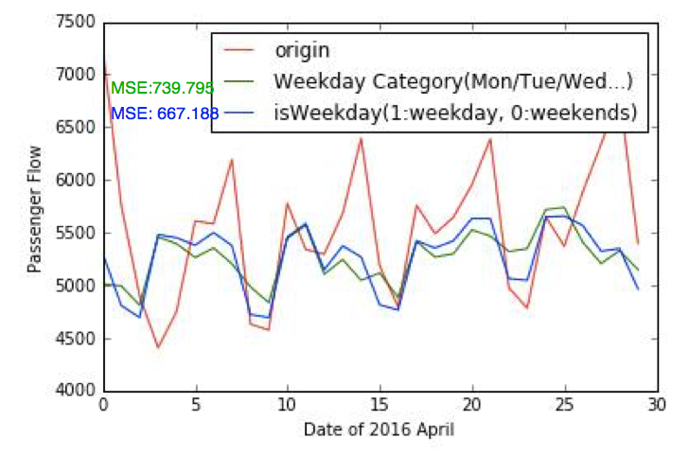
SVR Feature selection
(Songshan Airport Station)
Weekday? Or Weekends? → Better

Slide 16
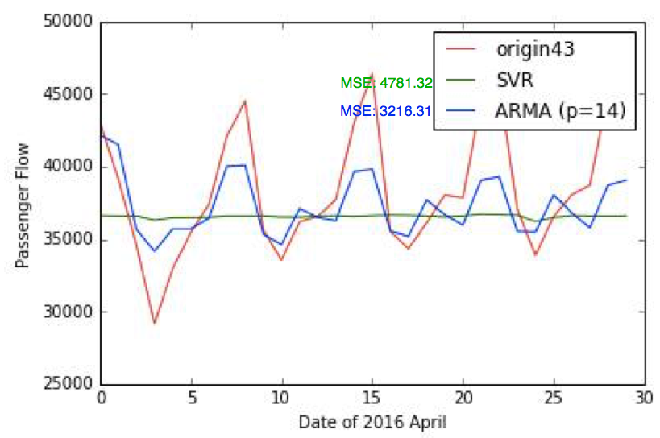
ARMA Helps
(Zhongshan Station)
Weekday Features not work ☹
ARMA: Cycle feature ☺

Slide 17
Conclusion
Standardize is important! (Center to the mean and component wise scale to unit variance.)
Cycle feature is the key pattern in metro flow
ARMA does well in cycle prediction
SVR can include different types of feature. Scalable⬆
Different metro station has its own pattern and suitable model/ feature.
Ordinary Pattens -> Event prediction

Slide 18
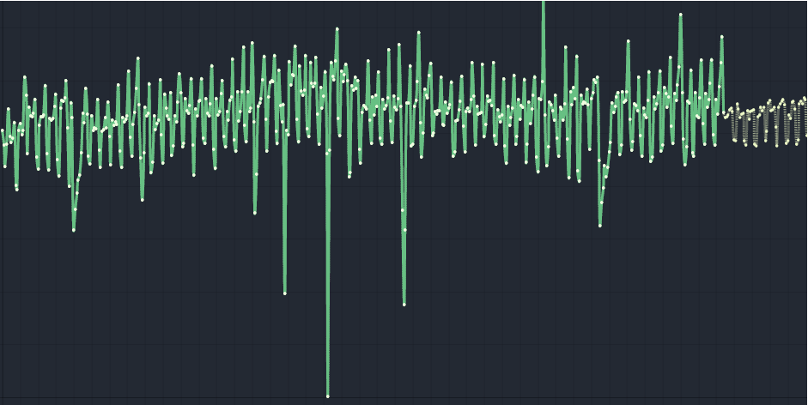
Next step: Event prediction…
(Songshan Airport Station)
(2015.8.8 Soudelor Typhoon)

Slide 19
Next step: Event prediction…
(Sodagreen)
(Taipei Arena Little Huge Egg)

Slide 20
Thanks / Q&A

